Slide 1
Introduction to Info. & Comm. Technology
14-12-2023

Slide 2
Ex-1
The date June 10, 1960 is special because when we write it in the following format, the month times the day equals the year.
6/10/60
Write a program that asks the user to enter a month (in numeric form), a day, and a two-digit year
The program should then determine whether the month times the day is equal to the year
If so, it should display a message saying the date is magic, otherwise it should display a message saying the date is not magic.

Slide 3
Ex-2
The area of a rectangle is the rectangle’s length times its width.
Write a program that asks for the length and width of two rectangles. The program should tell the user which rectangle has the greater area, or if the areas are the same.

Slide 4
Ex-3
Write a program that asks the user to enter the month (letting the user enter an integer in the range of 1 through 12)
The program should then display the number of days in that month
Hint: month number:1,3,5,7,8,10,12 → 31 days, otherwise 30 days
Let’s assume that we don’t have to take care of the leap year, Feb will always have 29 days

Slide 5
Ex-4
Get an integer as input in variable x
Ask the user to enter A or B
If the user enters A, your program calculates cube of x and displays the value of x and the cube
If the user enters B, your program adds 100 to x and then divide by 10. The output this time is value of x and the remainder after division

Slide 6
Ex-5
Ask the user to enter the number of hours worked. If the hours worked are greater than 40 per week then calculate the overtime payment.
The payment will be equal to number of overtime hours multiplied by 450 rupees (rate = Rs.450/hour).
Display the over time hours and the amount earned on overtime worked

Slide 7
Ex-6
Ask the user to enter a character from the keyboard. Your program should convert the character into an ASCII code.
Use int(any character) built-in function to convert into ASCII code

Slide 8
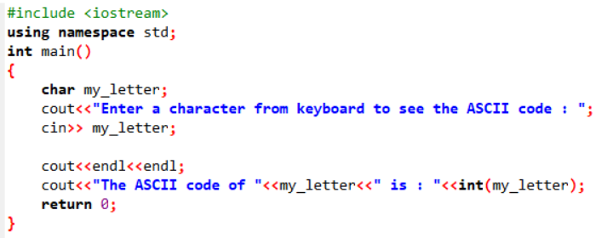
Solution –Ex-6

